Slide 1
DELight Demonstrator Update
Collaboration Meeting @ UFR
18.06.2025

Slide 2
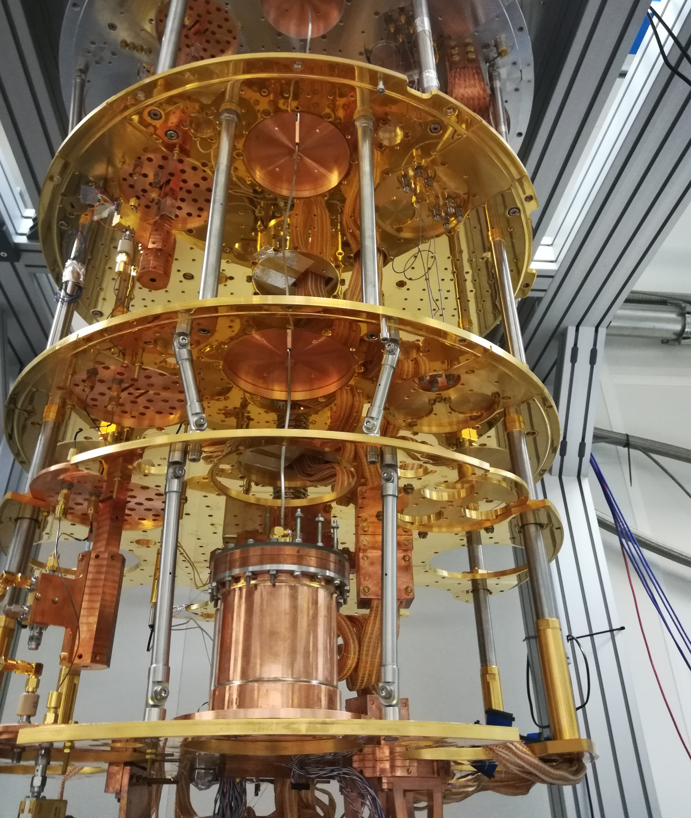
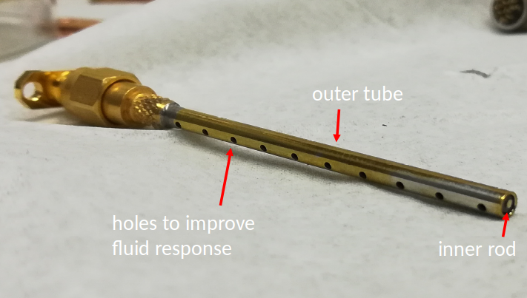
Recap of Previous results
In the first cooldowns of the proto-cell a temperature ~1 K could be reached
Helium was filled through a capillary with a diameter of 1.5 mm
A level meter was installed
LC-circuit with changing resonance frequency due to change of dielectric constant between outer tube and inner rod
capillary

Slide 3
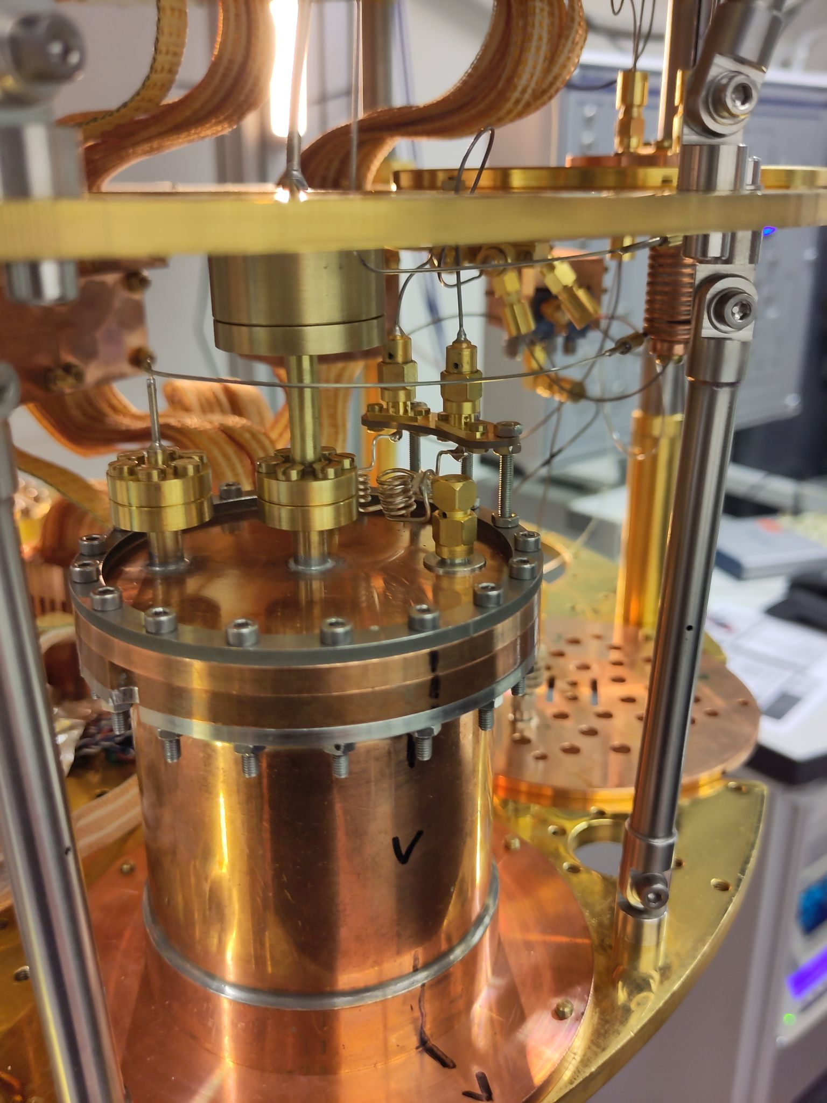
Reaching a Lower Temperature
thicker capillary + burst disk
The cell could not be cooled down to the desired temperature below 20 mK due to the large diameter of the capillary and poor thermal coupling
superfluid film flow causes heat exchange between the different stages
helium entering the cell at high temperatures
A capillary of 0.2 mm between the stages with heat exchangers (0.6mm thick capillary wrapped around and copper rod) on each stage were used instead
Problems evacuating the cell through this capillary
Capillary blocked due to frozen air
thinner capillary

Slide 4
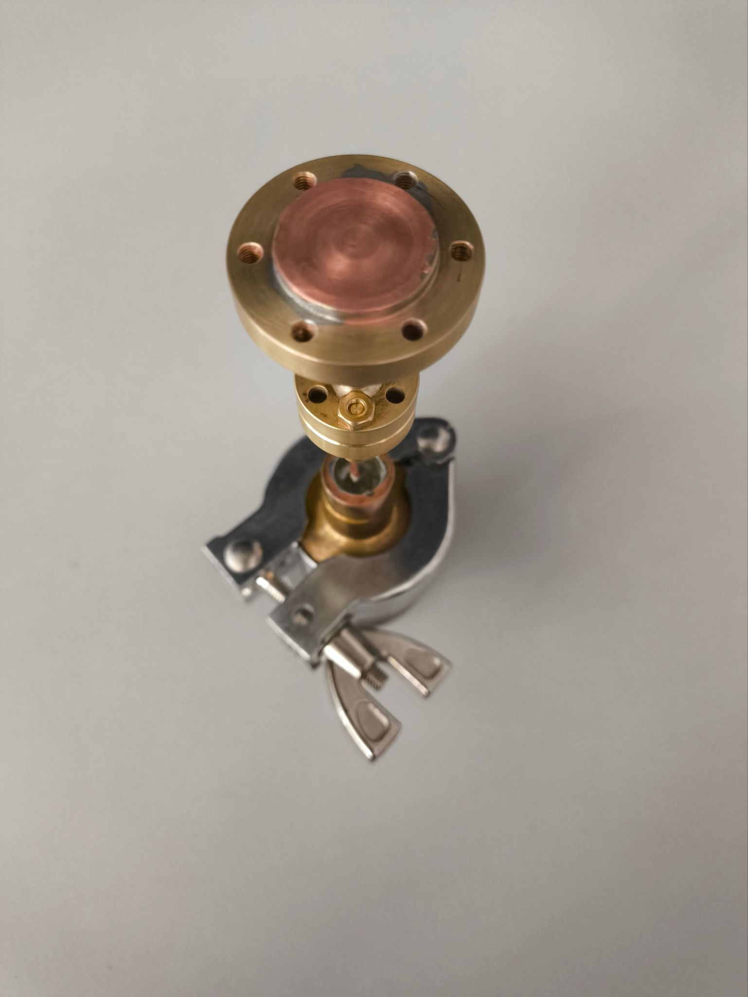
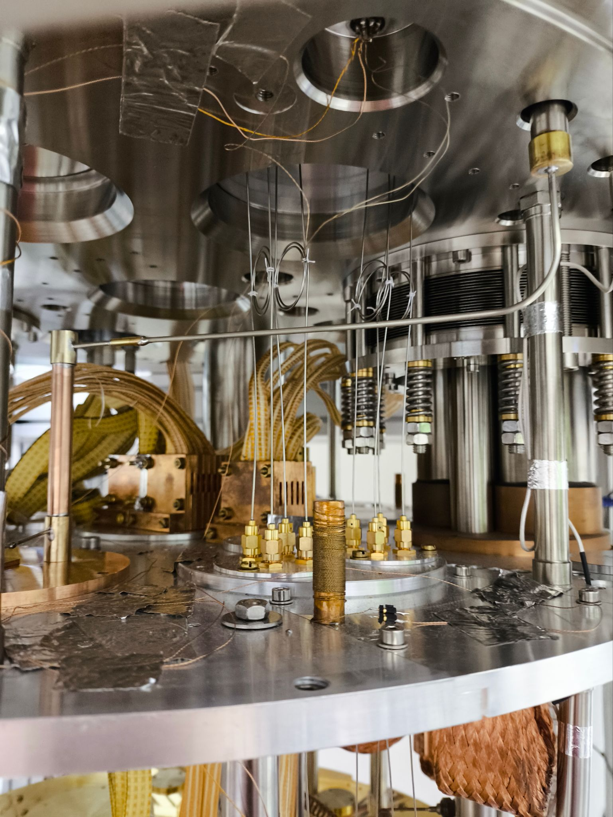
Reaching a Lower Temperature
Adding a cooling trap at the 50K stage to freeze out “dirt” entering from the outside
Flushing the cell multiple times with Helium prior to cooldown to remove air from the inside
Additional installation of a burst disc connected to the old 1.5mm thick capillary as an additional way out in case of a blocked capillary or an unexpected fast warmup
→ A lower temperature of ~15 mK could be reached with this set-up → This permits to operate the sensor
burst disk
cooling trap

Slide 5
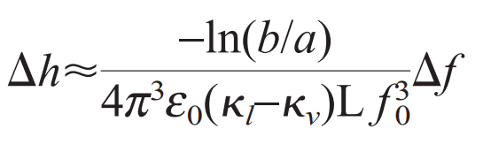
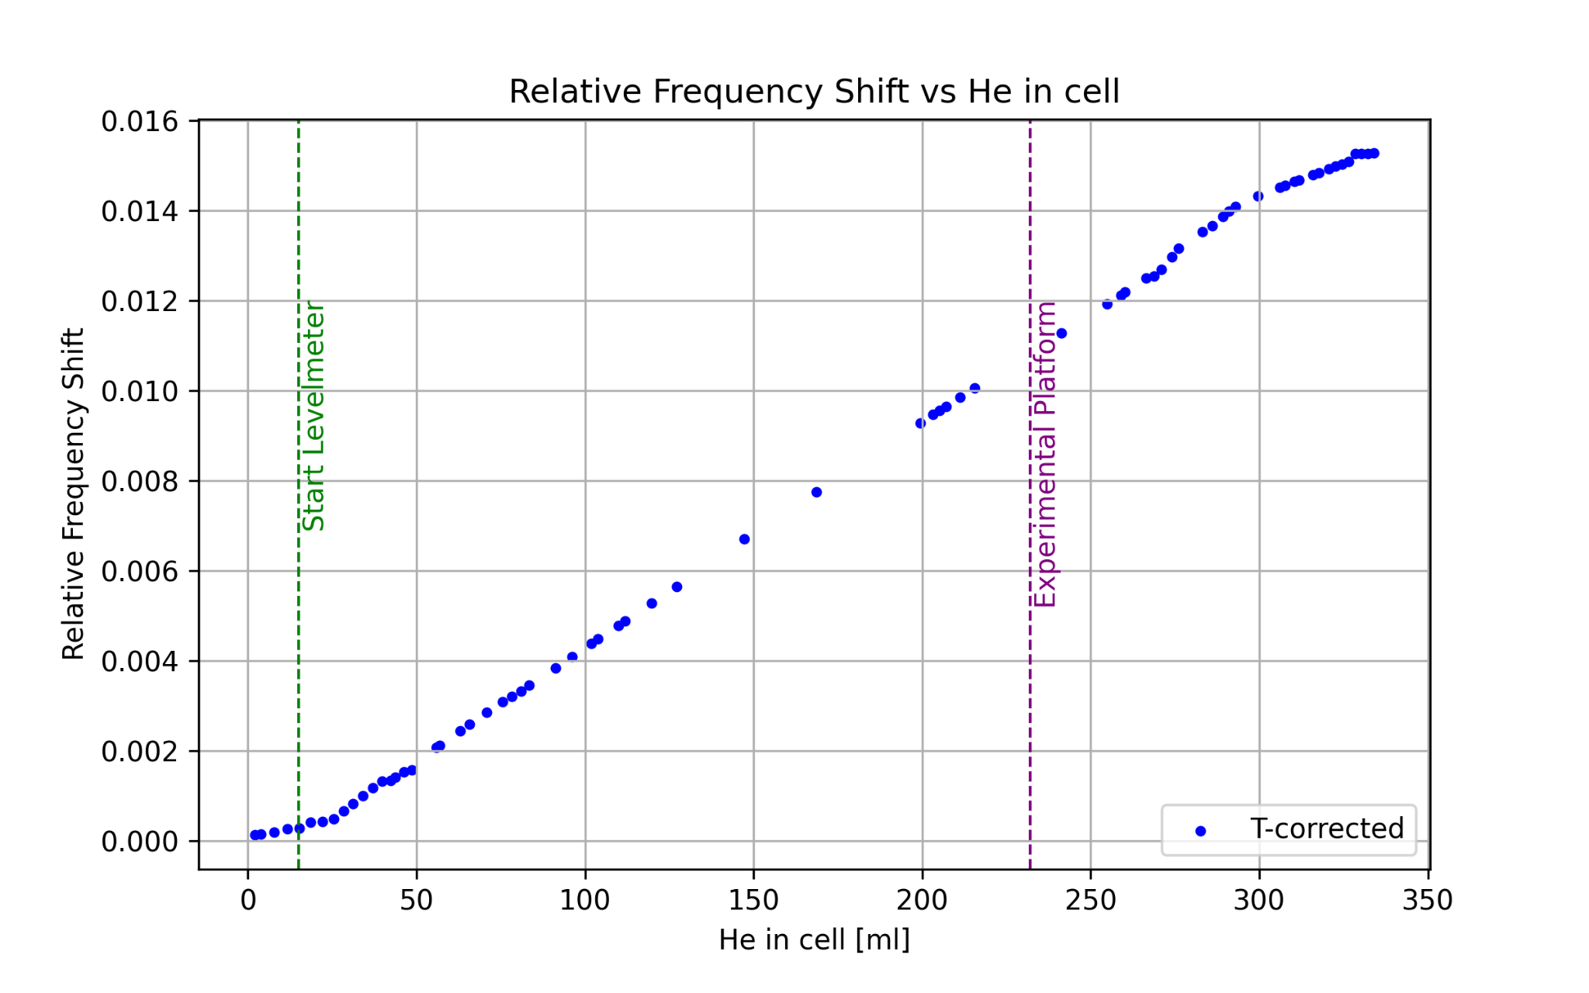
Level meter Calibration
Calibration of demonstrator completely filled
Issues caused by miscalibrated vacuum gauge
New, calibrated digital vacuum gauge is being ordered
Retrospective data calibration underway
Correction for object in cell (experimental platform was still installed)

Slide 6
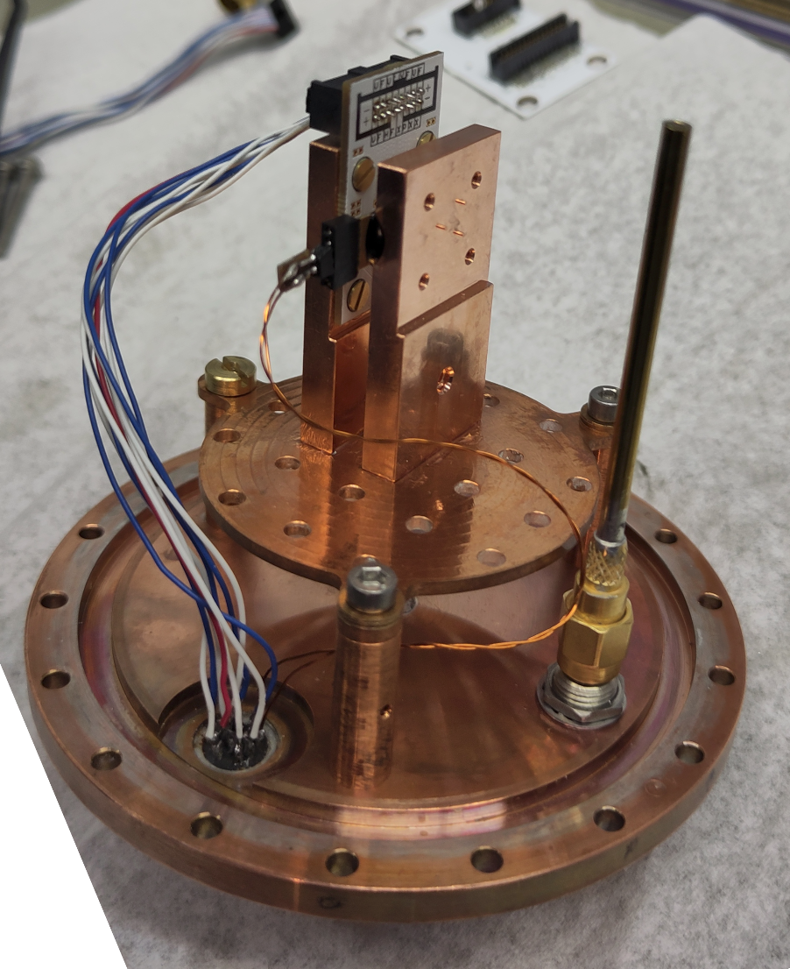
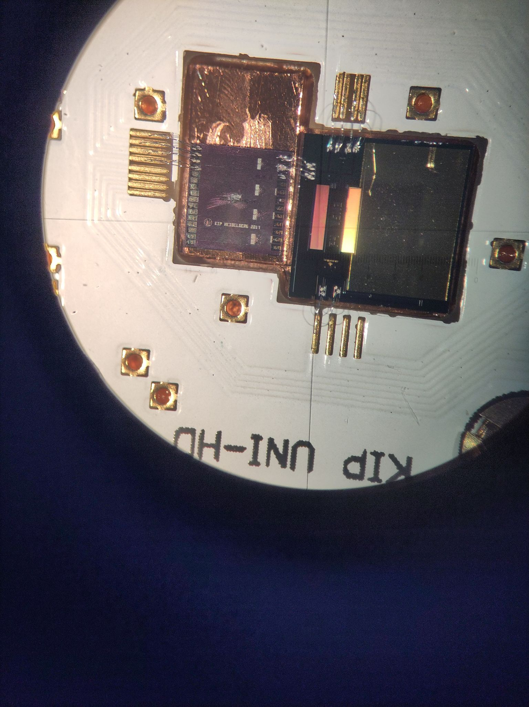
Current Detector Setup
An MMC and a heater have been installed in the cell
Heater with a resistance of 56 Ohm
MMC resting on thin pillars to reduce thermal coupling to the holder
These two items have been placed on copper plates that will be submerged in the liquid helium
Only 1/3 of the volume is necessary for this
Heater placement
MMC connected to SQUID
Connection to outside of the cell

Slide 7
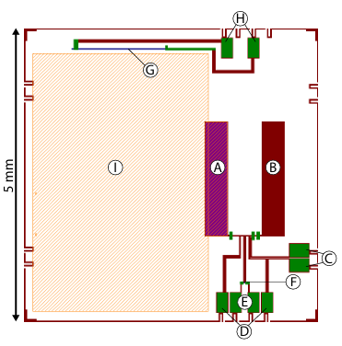
Detector setup
Strongly asymmetric to provide temperature sensibility
On chip heater for testing
Components:
A: pick-up coil with AgEr on top
B: pick-up coil without
C: Squid readout lines
D: Field lines for persistent current preparation
E: Heater lines for persistent current preparation
F: AuPd heater for persistent current preparation
G: AuPd heater (500 Ohm) for on chip tests pulses
H: Heater connection pads
I: Gold area used in other applications of this MMC

Slide 8
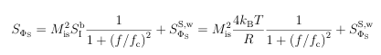
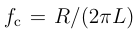
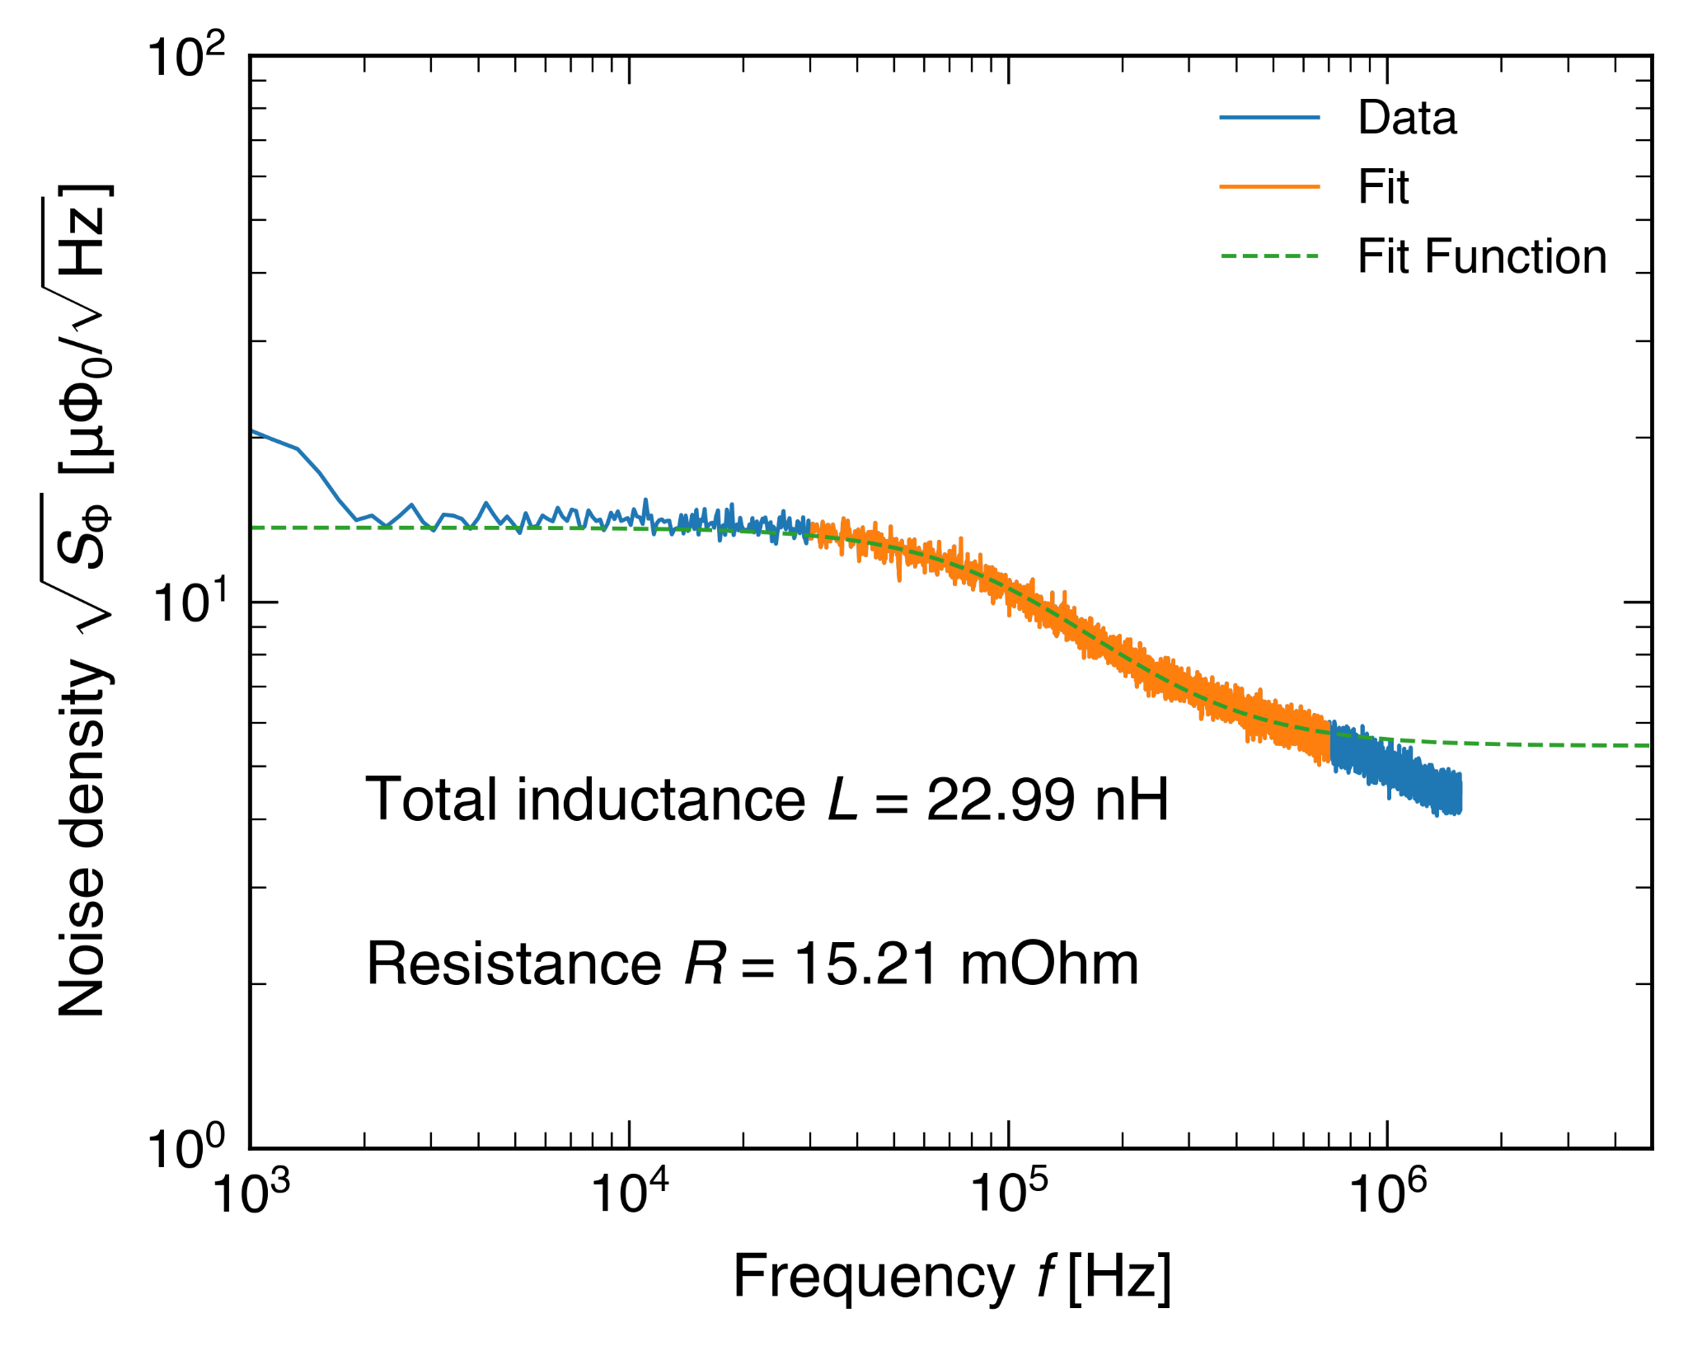
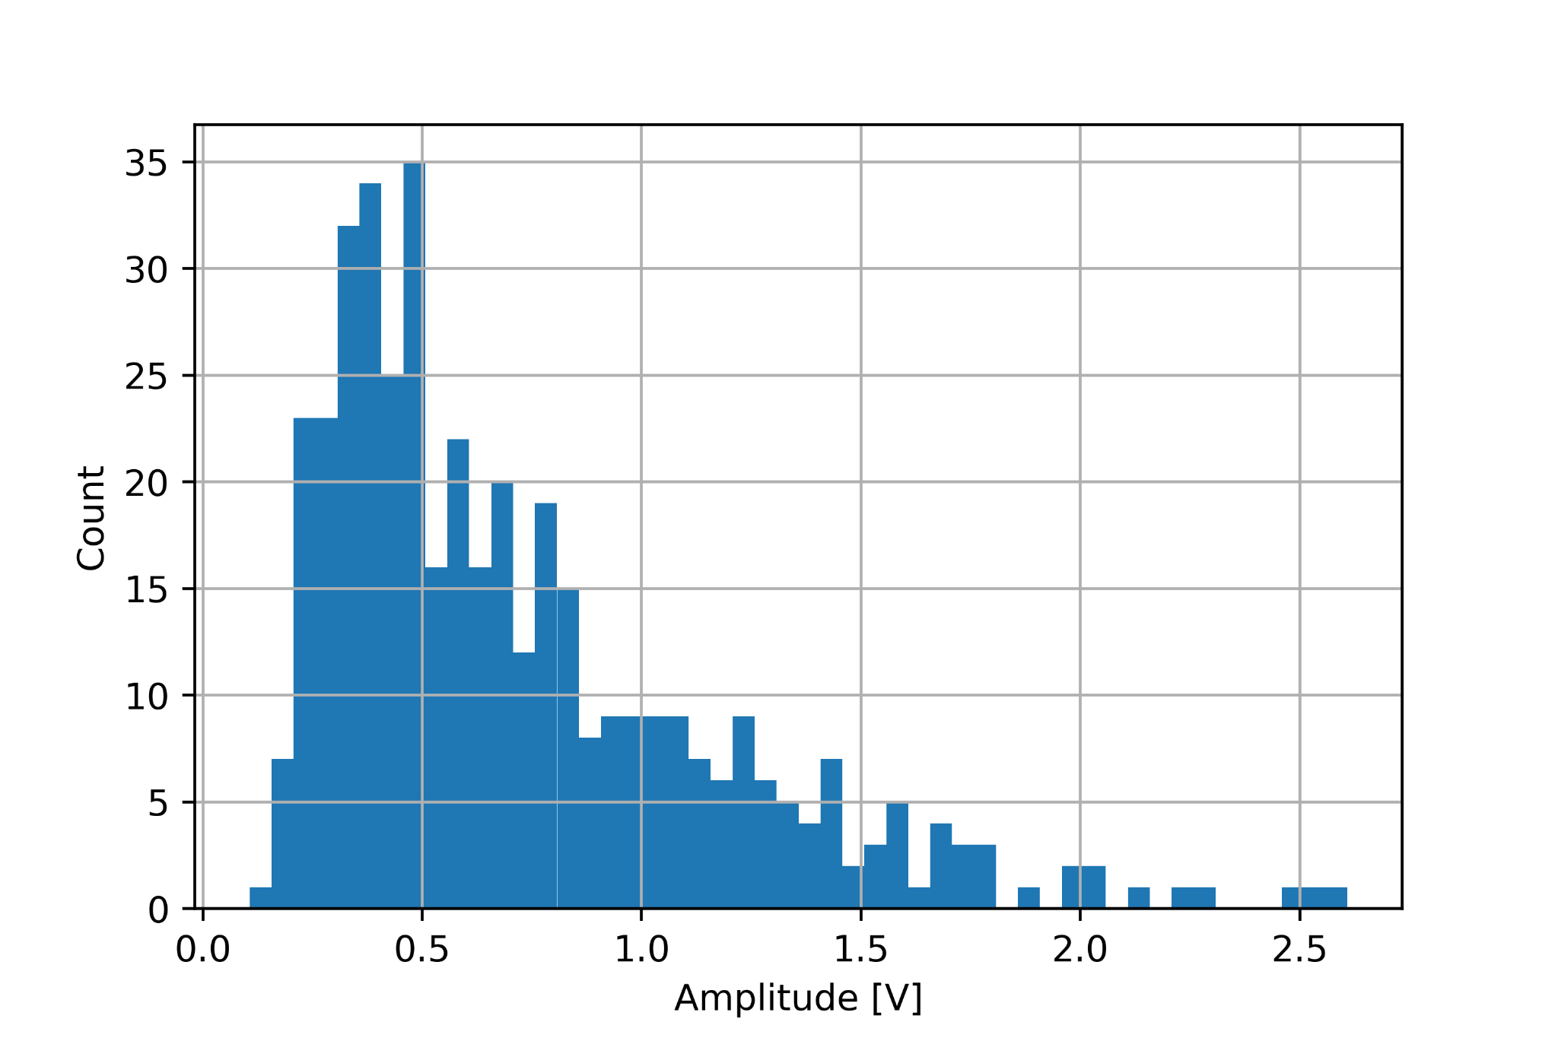
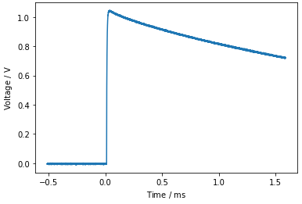
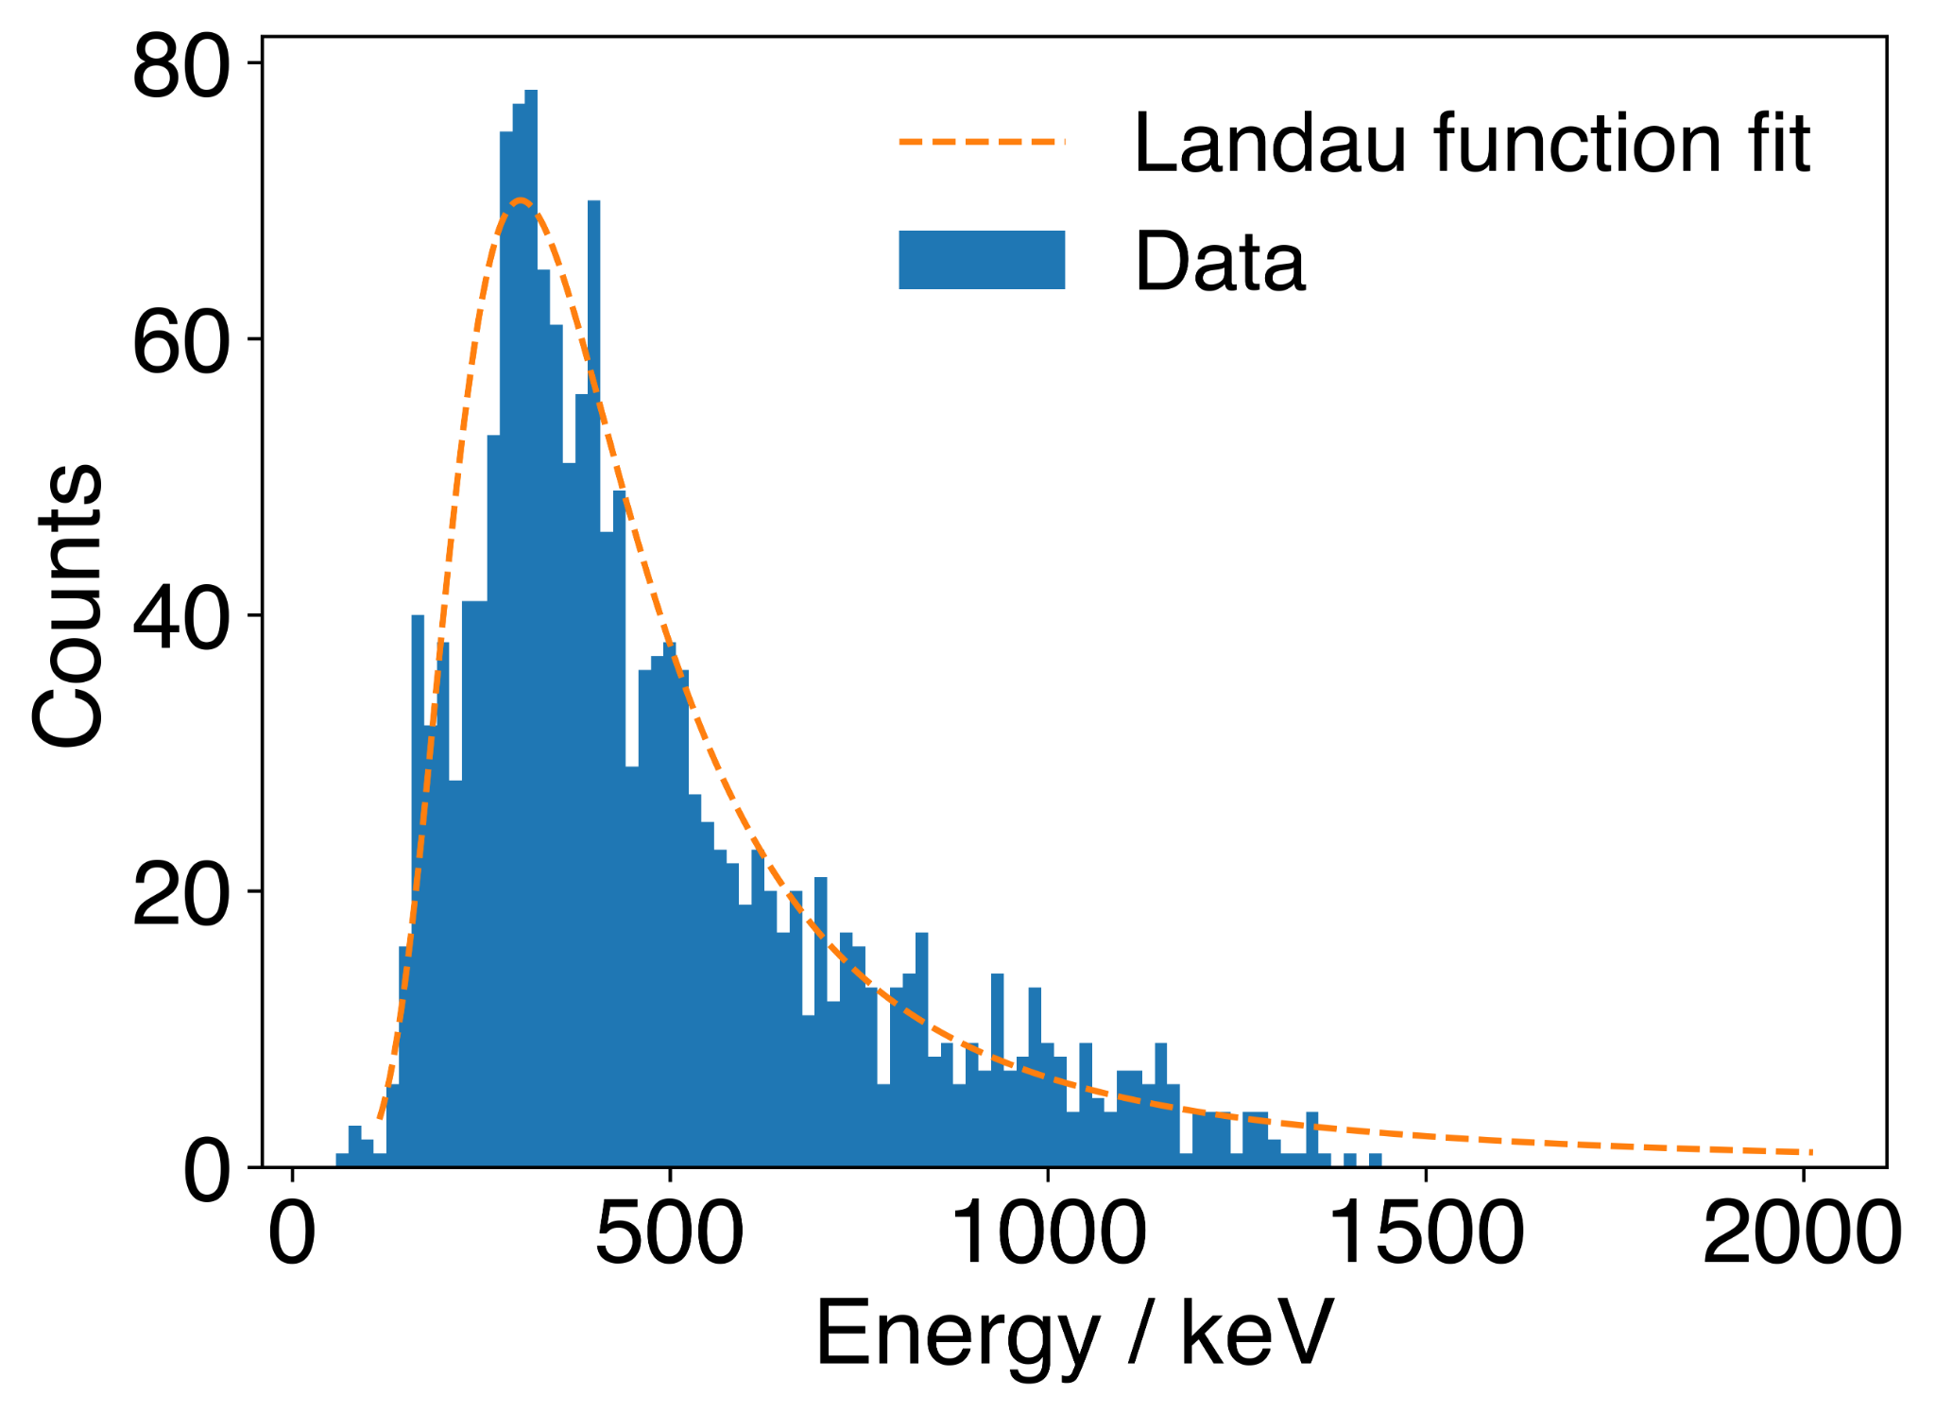
First Measurement Data
,
The detector works !!!
First Pulses observed
First measurement of muon spectrum (low statistics)
Shape of spectrum consistent with a comparable setup
Inductance extracted from noise spectrum
matches theoretical expectation
Sample Pulse
First Muon Spectrum
Comparison Muon Spectrum

Slide 9
Current Status
Due to problems in other projects the cryostat was warmed up over the weekend and cooldown started yesterday
Other experiments from the group are also inside
→ the cell will be most likely be filled with helium only after their data collection
The goal of this measurement is to
Do a magnetization measurement
Get information about persistent current and detector temperature
Measure a muon spectrum with more statistics
observe the response to heater pulses of different energies (with empty and filled cell)

Slide 10
Future Plans
Measure quasiparticle spectrum in liquid Helium
Hopefully already achievable in this run
Consider fabrication of air-bridge-like heater
To achieve point-source-like excitation
Potentially switching to a different MMC
Test additional components of the experiment
Superconducting stepper motors
Reflectivity of phonons
etc

Slide 11
BACKUP

Slide 12
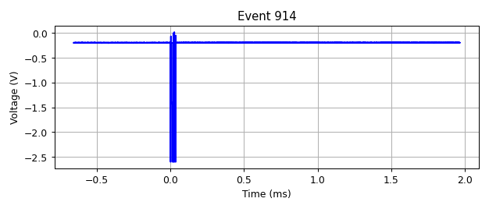
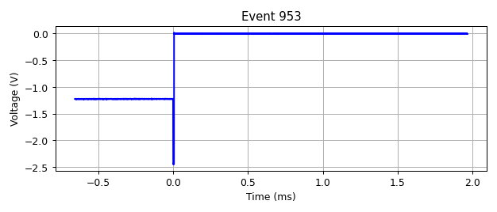
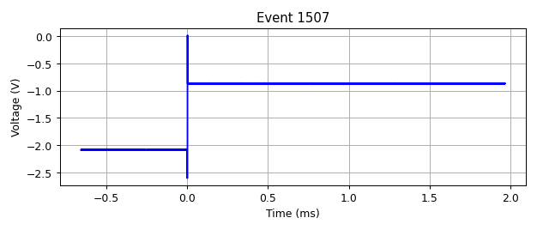
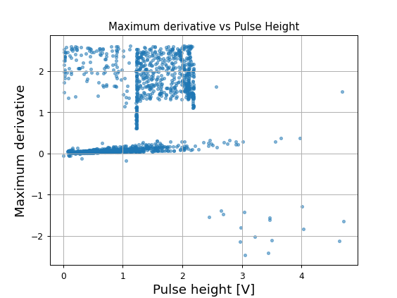
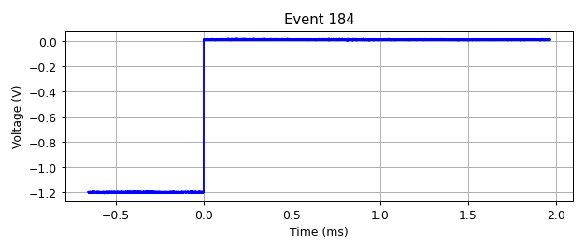
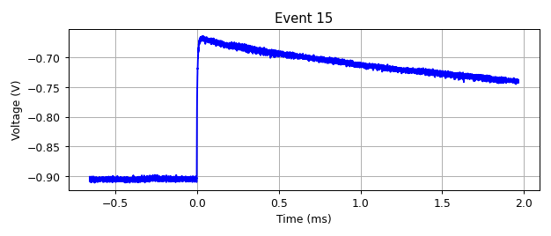
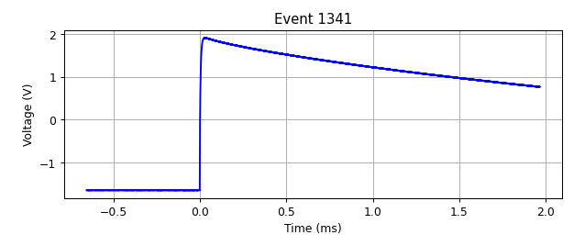
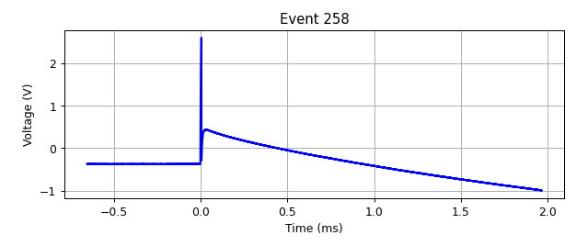
Data Quality

